Slide 1

A Project Presentation on
Blood Bank Management System
Under Taken At
:-SUBMITTED TO-:
College Of Computer & Management Studies,Vadu
:-SUBMITTED BY-:
Chauhan Amit
Krushang Parekh
:-UNDER THE GUIDENCE OF-:
Santoshi Senguntuhar

Slide 2
PROJECT OBJECTIVES
The main Objective of the project is to design and develop the online site which enables the user to make the Send Request To blood,Blood Donation etc..
This Softwere helps hosptial to find Blood Management.
It is designed such a way that one can view Blood Bank Management System.
The software will helps is easy maintaining Different type of blood In Blood Bank.

Slide 3
INTRODUCTION
The Project is aimed at developing a Web application that depends in Blood Bank Management System.
Using this software,hospital & Blood Bank can improve the efficiency of their services.
Blood Bank Management System is one of the web applications to improve the Patient blood requirement for hospital & Blood Bank.
This web applicaton involves all the features of the Blood Management in hospital & Blood Bank.

Slide 4
About Project
The BLOOD BANK MANAGEMENT SYSTEM is great project. this project is designed for successful completion of project on blood bank management system, the basic building aim is to provide blood donation service to the city recently.
Blood Bank Management System (BBMS) is a browser based system that is designed to store, process, retrieve and analyse information concerned with the administrative and inventory management within a blood bank.
This project aims at maintaining all the information pertaining to blood donors, different blood groups available in each blood bank and help them manage in a better way.
Aim is to provide transparency in this field, make the process of obtaining blood from a blood bank hassle free and corruption free and make the system of blood bank management effective.

Slide 5
Existing System
Bank blood donation system in java is planned to collect blood from many donators in short from various sources and distribute that blood to needy people who require blood.
Blood Bank Management System (BBMS) is a browser based system that is designed to store, process, retrieve and analyse information concerned with the administrative and inventory management within a blood bank.
This project aims at maintaining all the information pertaining to blood donors, different blood groups available in each blood bank and help them manage in a better way
Aim is to provide transparency in this field, make the process of obtaining blood from a blood bank hassle free and corruption free and make the system of blood bank management effective.

Slide 6
PROJECT PROFILE
Project Title:- | Blood Management System
Front End:- | PHP,HTML,Javascript
Back And:- | MY SQL Server
Operating System:- | Window 10

Slide 7
PREFERABLE HARDWERE REQUIREMENT

Slide 8
PREFERABLE HARDWARE REQUIREMENT
Hardware Requirement(Devloper’ s side)
PROCESSOR | Minimum Intel i3
RAM | 1 GB RAM or Higher
HDD | 500 GB HDD or higher
MONITOR | 17” VGA
Hardware Requirements (User’s side)
PROCESSOR | Pentium II&Iv
RAM | 1 GB RAM or Higher
HDD | 250 GB HDD or higher
MONITOR | 17” VGA

Slide 9
PREFERABLE SOFTWARE REQUIREMENT

Slide 10
PREFERABLE SOFTWARE REQUIREMENT
Software Requirements (Developer’s side)
Operating System | Microsoft Window 10
Front End | Notepad ++ & Any Other Editor
Back End | MS SQL Server Xamp Apache
Software Requirements (User’s side)
Operating System | Microsoft Window 10
Back End | MS SQL Server Xamp Apache

Slide 11
Module
Admin
Donar Registration
Send Reguest For Blood
User Login
Search Blood

Slide 12
E.R. DIAGRAM

Slide 13
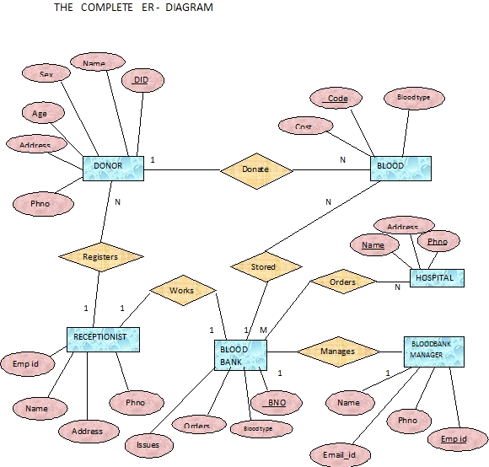

Slide 14
DATA FLOW DIAGRAM

Slide 15
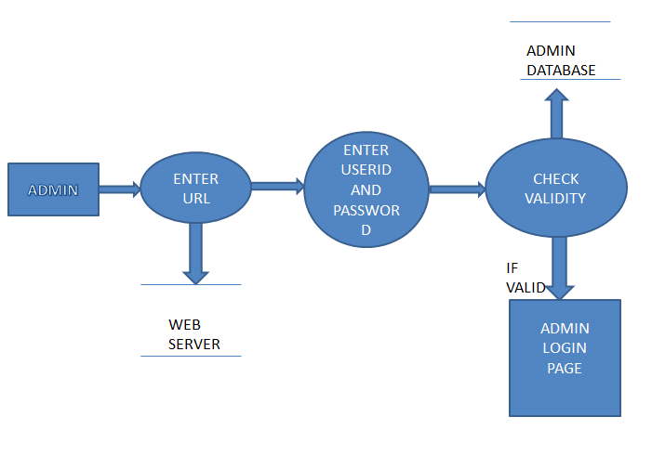
Admin Login

Slide 16
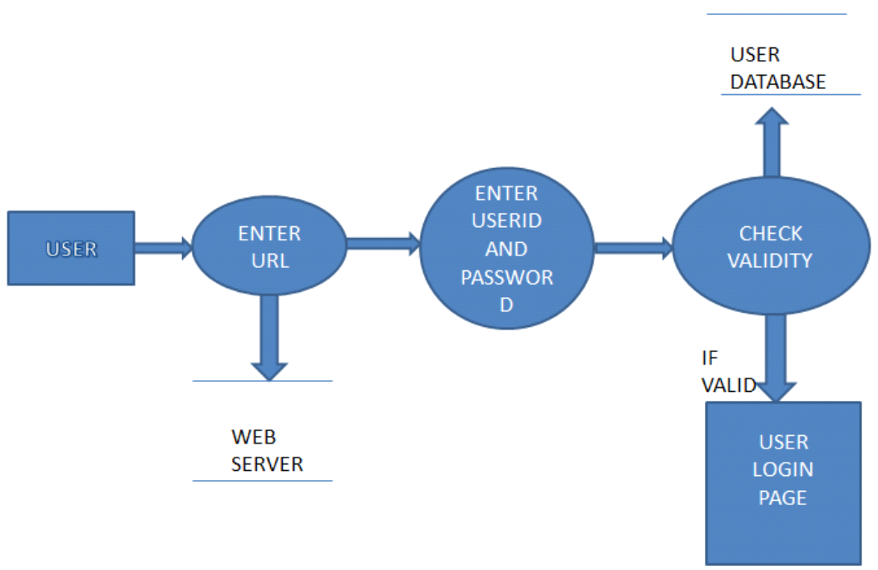
User Login

Slide 17
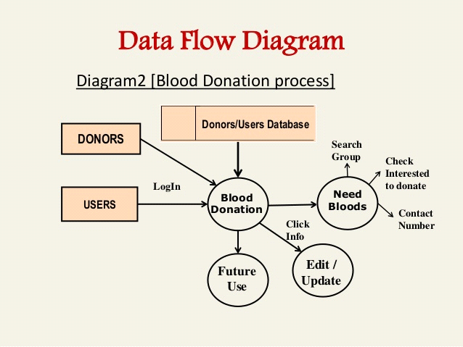

Slide 18
DATA DICTIONARY
List Of Table Name
Advertisement
Blood Group
Camp
City
Contacts
Donar Registration
Donation
Gallery
News
Requests
State
User

Slide 19
Table Name Advertisement
Field name | Data type | Constraint | Description
Adv_id | Int(100) | Primary Key | Advertisement Id
Camp_title | Varchar(100) | Not Not | Campinas Title
Org_by | Varchar(100) | Not Null | Organize Name
Pic | Varchar(700) | Not Null | Image
detail | Varchar(900) | Not Null | For Details
Table Name Blood Group
bg_id | Int(100) | Primary Key | Blood Group Id
bg_name | Varchar(100) | Not Null | Blood Group Name
Table Name Camps
camp_id | Int(100) | Primary Key | Camp id
camp_title | Varchar(500) | Not Null | Camp Name
Organised_by | Varchar(500) | Not Null | Organised Name
State | Int(100) | Not Null | State Name
City | Int(100) | Not Null | City Name
pic | Varchar(900) | Not Null | Image
Detail | Varchar(1000) | Not Null | Details

Slide 20
Table Name City
Field name | Data type | Constraint | Description
city_id | Int(100) | Primary Key | City Id
city_name | Varchar(100) | Not Null | City Name
pin_code | Varchar(100) | Not Null | Pincode
district | Varchar(100) | Not Null | District Name
State | Int(100) | Not Null | State Name
Table Name Contact
row_id | Int(100) | Primary Key | Row id
name | Varchar(100) | Not Null | Name
email | Varchar(100) | Not Null | Email
mobile | Varchar(100) | Not Null | Mobile No
subj | Varchar(700) | Not Null | Subject

Slide 21
Table Name Donor Registration
Field name | Data type | Constraint | Description
donar_id | Int(100) | Primary Key | Donar Id
name | Varchar(100) | Not Null | Name
gender | Varchar(100) | Not Null | Gender
age | Varchar(100) | Not Null | Age
mobile | Varchar(100) | Not Null | Mobile No
b_id | Int(100) | Not Null | Blood Group
email | Varchar(100) | Not Null | Email Address
pwd | Int(100) | Not Null | Password
pic | Varchar(100) | Not Null | Image
Table Name Donation
donation_id | Int(100) | Primary Key | Donation Id
camp_id | Int(100) | Not Null | Camp Id
ddate | Datetime | Not Null | Donation Date
units | Int(100) | Not Null | Units
detail | Varchar(800) | Not Null | Details
email | Varchar(100) | Not Null | Email Address

Slide 22
Table Name Gallery
Field name | Data type | Constraint | Description
camp_id | Int(100) | Not Null | Canp Id
pic_id | Int(100) | Primary Key | Picture Id
title | Varchar(400) | Not Null | Title Name
pic | Varchar(800) | Not Null | Image
Table Name News
news_id | Int(100) | Primary Key | News Id
title | Varchar(100) | Not Null | Title Name
detail | Varchar(900) | Not Null | Details
Table Name Requests
req_id | Int(100) | Primary Key | Request ID
name | Varchar(100) | Not Null | Name
gender | Varchar(100) | Not Null | Gender
age | Varchar(100) | Not Null | Age

Slide 23
Field name | Data type | Constraint | Description
mobile | Varchar(100) | Not Null | Mobile No
email | Varchar(100) | Not Null | Email Address
bgroup | Int(100) | Not Null | Blood Group
reqdate | Datetime | Not Null | Request Date
detail | Varchar(500) | Not Null | Details
Table Name State
state_id | Int(100) | Primary Key | State ID
state_name | Varchar(100) | Not Null | State Name
Table Name User
username | Varchar(100) | Not Null | User Name
pwd | Varchar(100) | Not Null | Password
typeofuser | Varchar(100) | Not Null | Type Of User

Slide 24
SCREEN SHOTS

Slide 25
User Side
Home Page
Donor Registration Page
Send For Blood Request Page
View Request Page
Campinas Page
Login Page
Search Page
Contact Us Page
About Page

Slide 26
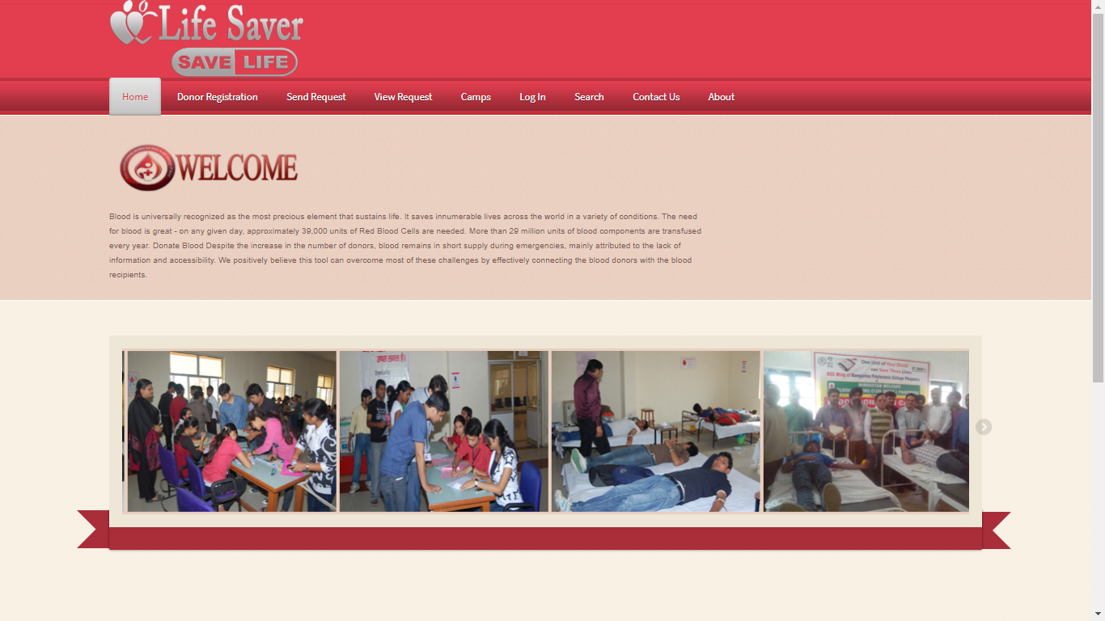
SCREEN SHOT
HOME :-

Slide 27
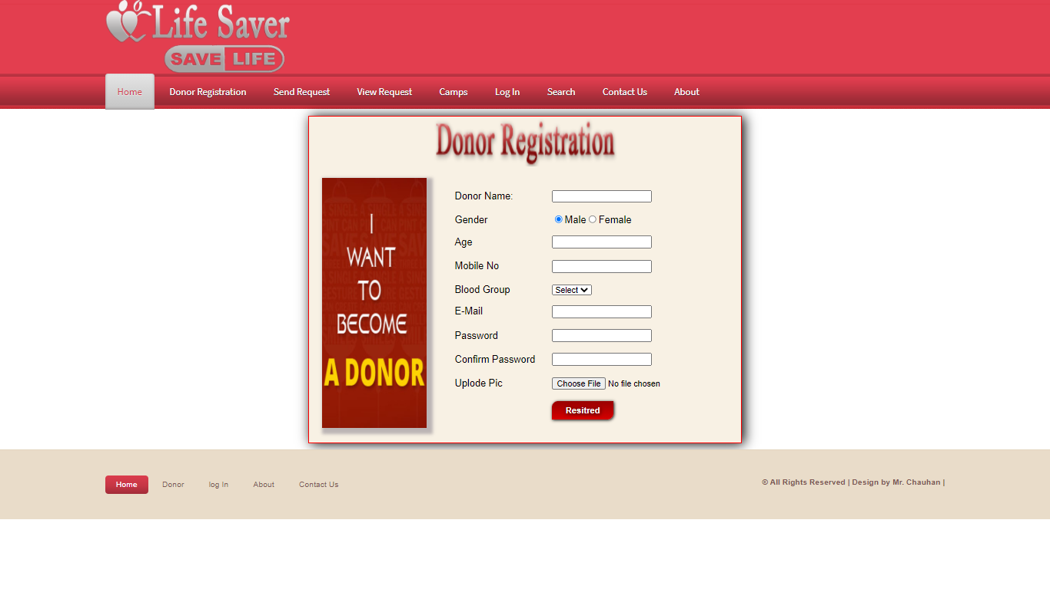

Slide 28
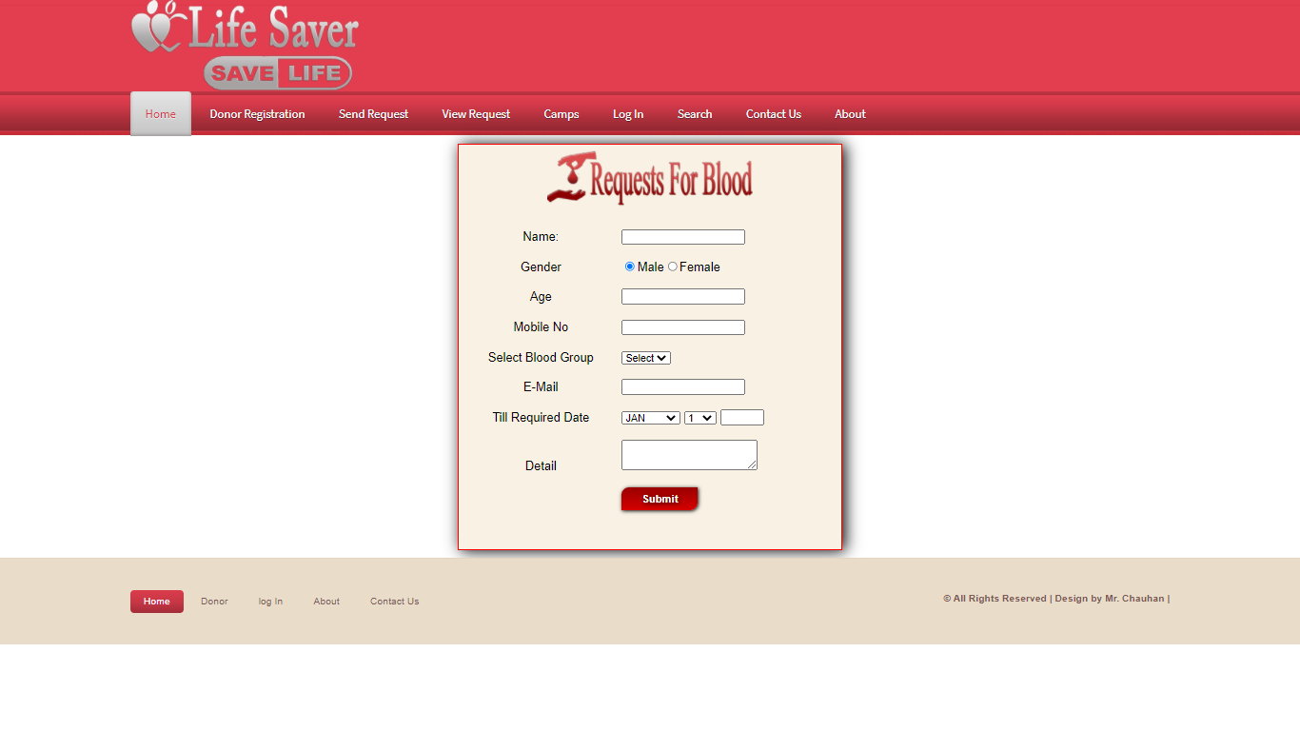

Slide 29
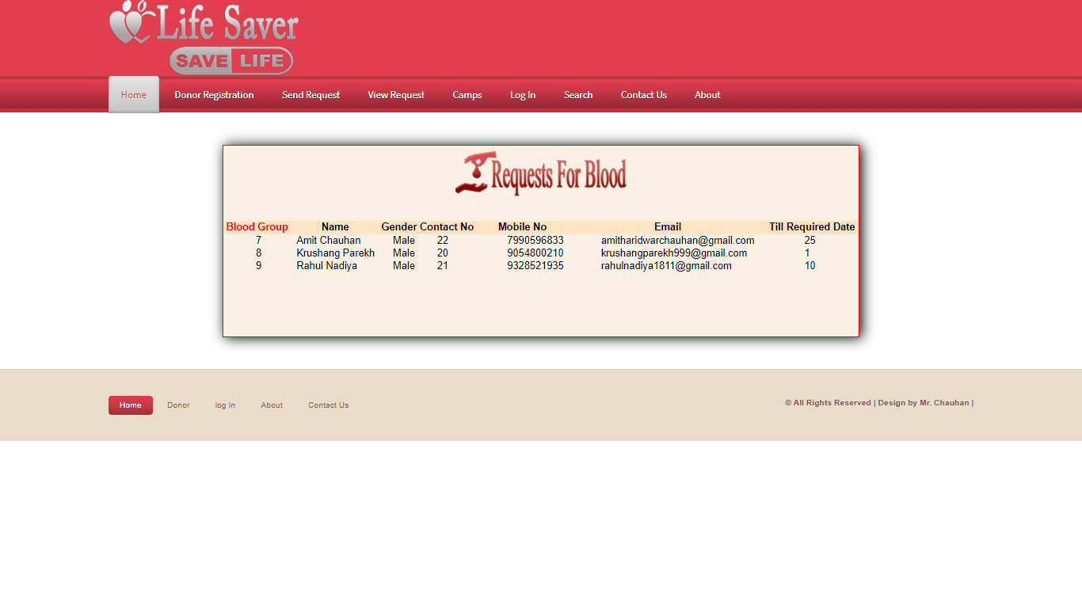

Slide 30
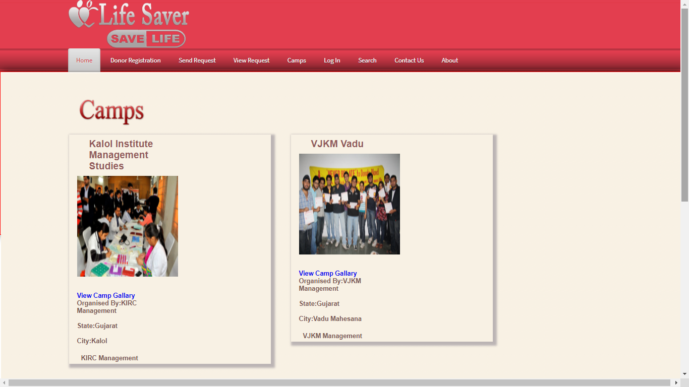

Slide 31
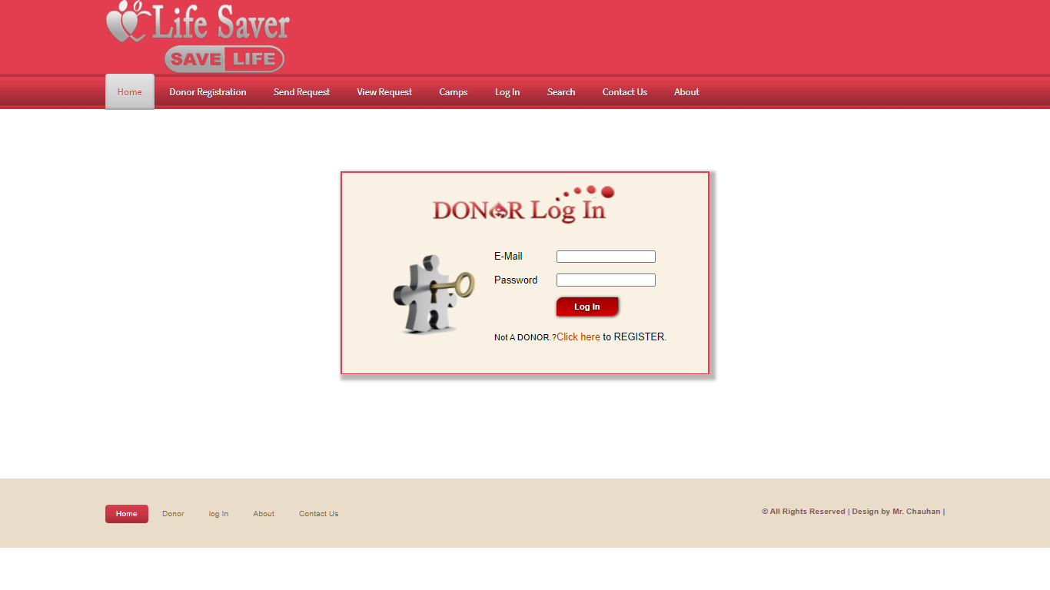

Slide 32
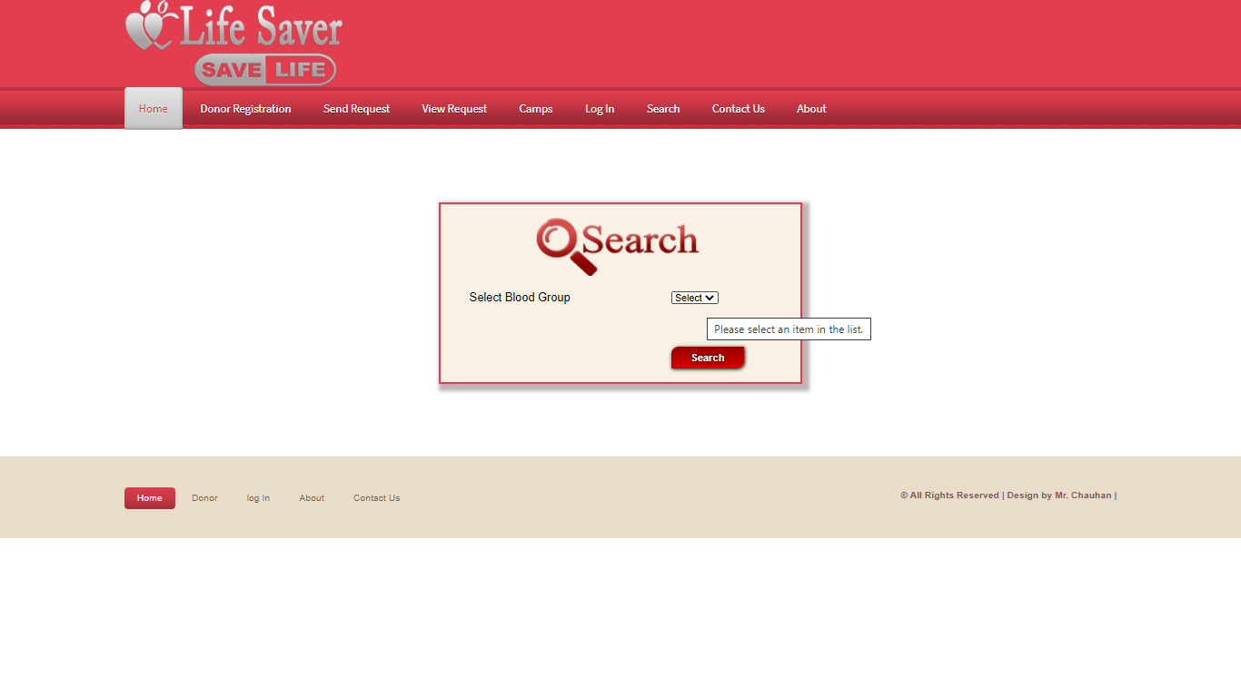

Slide 34
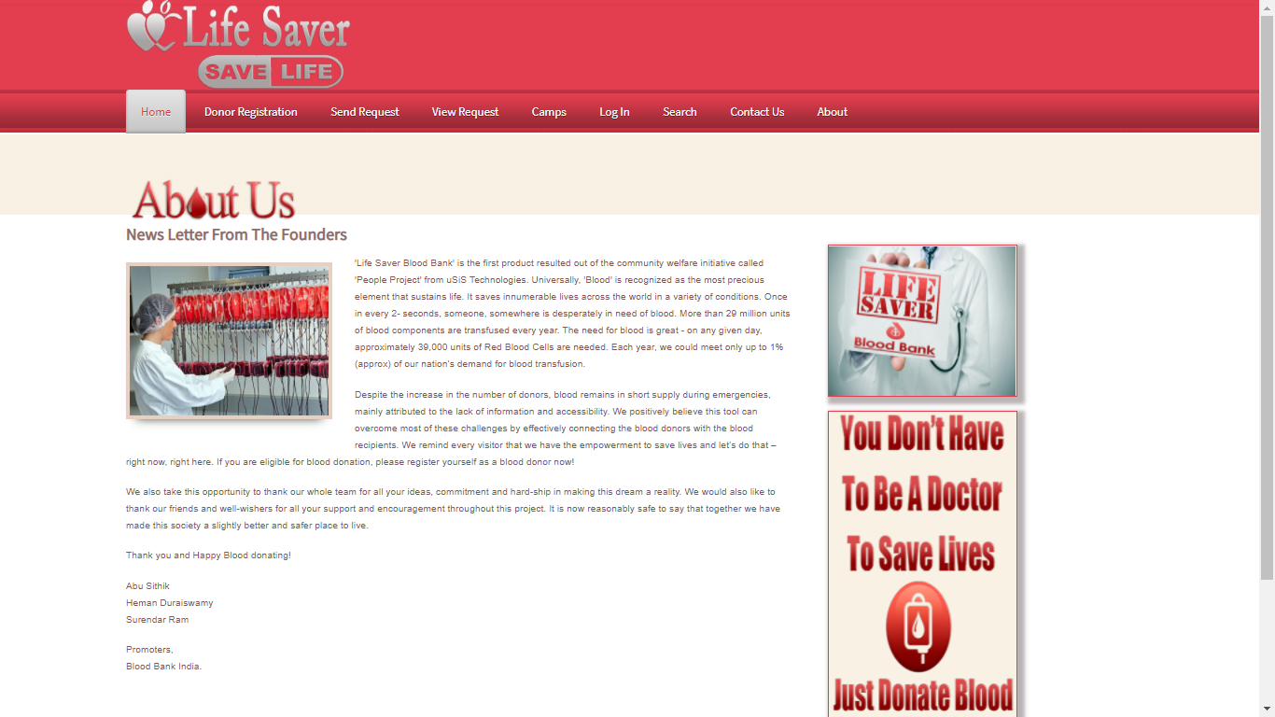

Slide 35
Admin Side
Admin Panel
Add User, Update User & Delete User
Add City, Update City & Delete City
Add State, Update State & Delete City
Add Camps, Update Camps & Delete Camps
Add Blood Grp, Updated Blood Grp & Delete Blood Group
Add Gallery & Delete Gallery
Add News & Delete News
Add Advertisement & Delete Advertisement
View City, View State, View Advertisement, View News, View Blood Grp & View Camps

Slide 36
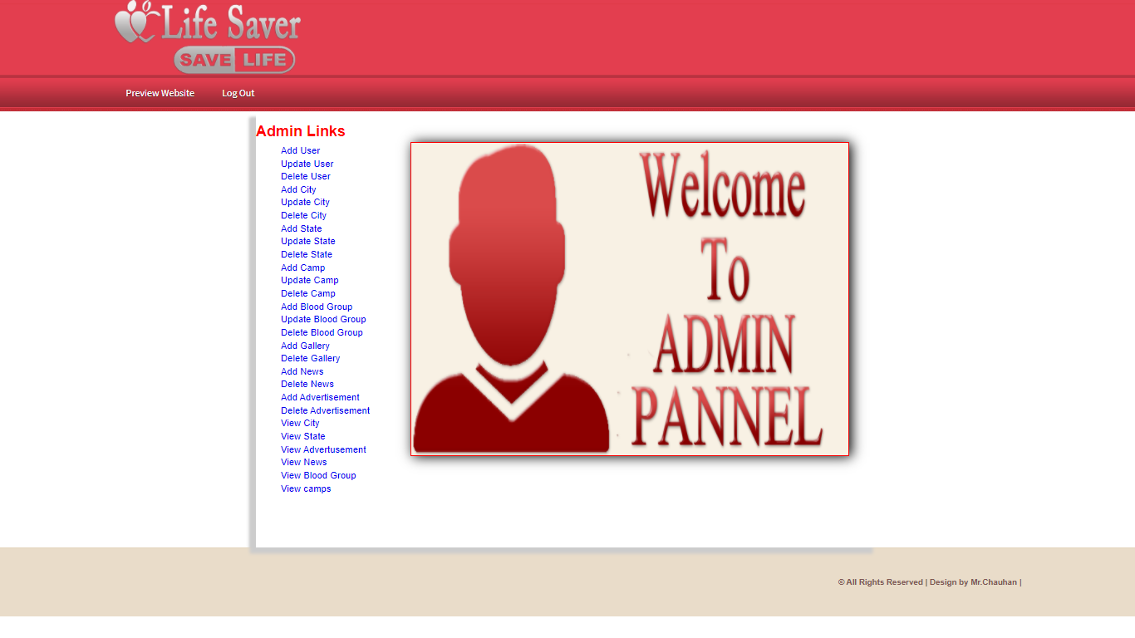

Slide 37
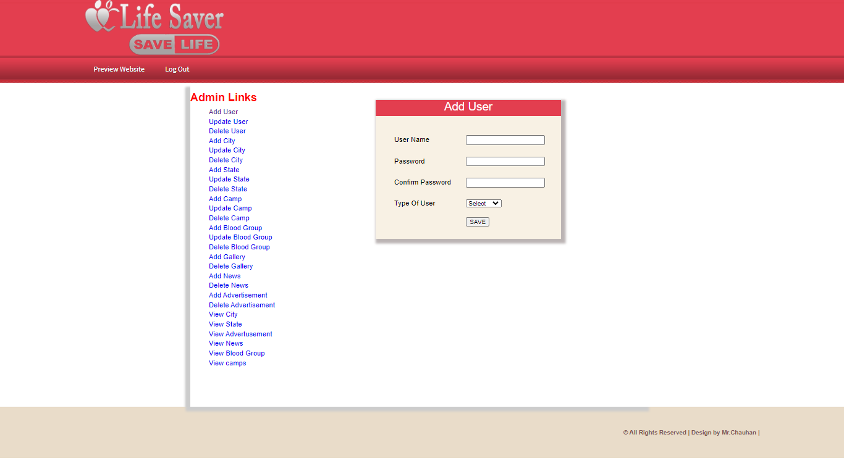

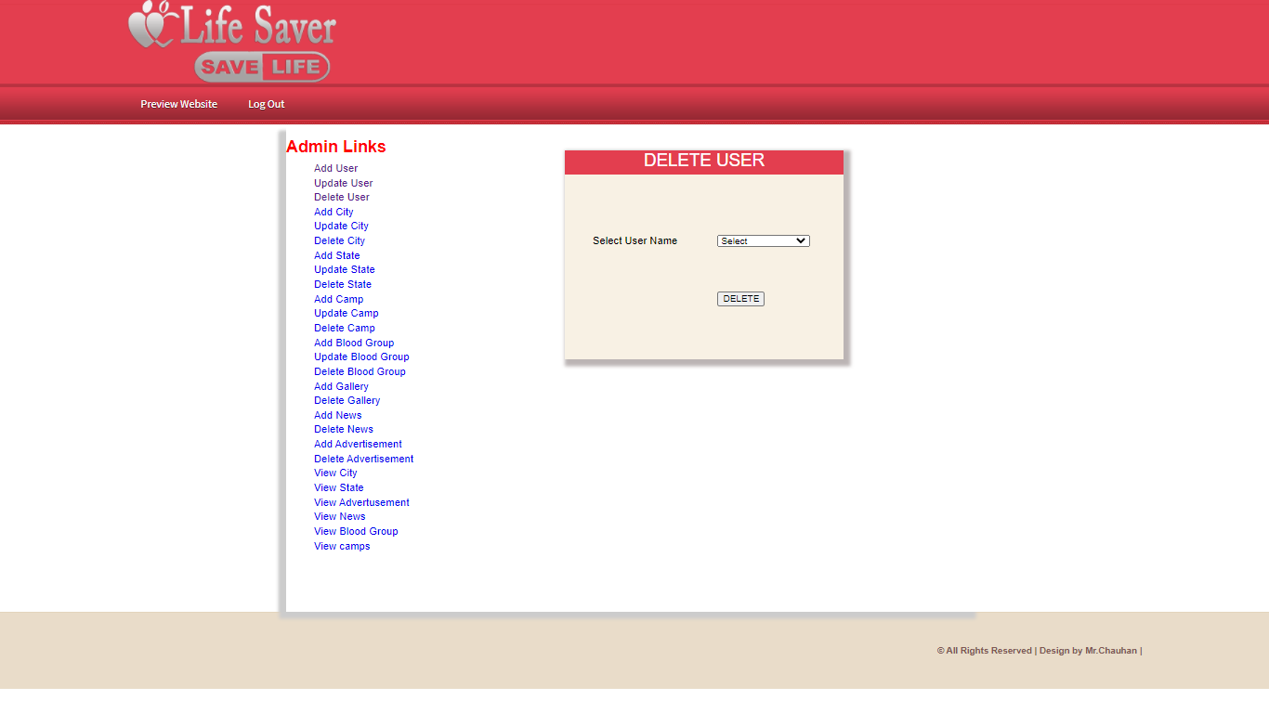

Slide 38




Slide 39




Slide 40
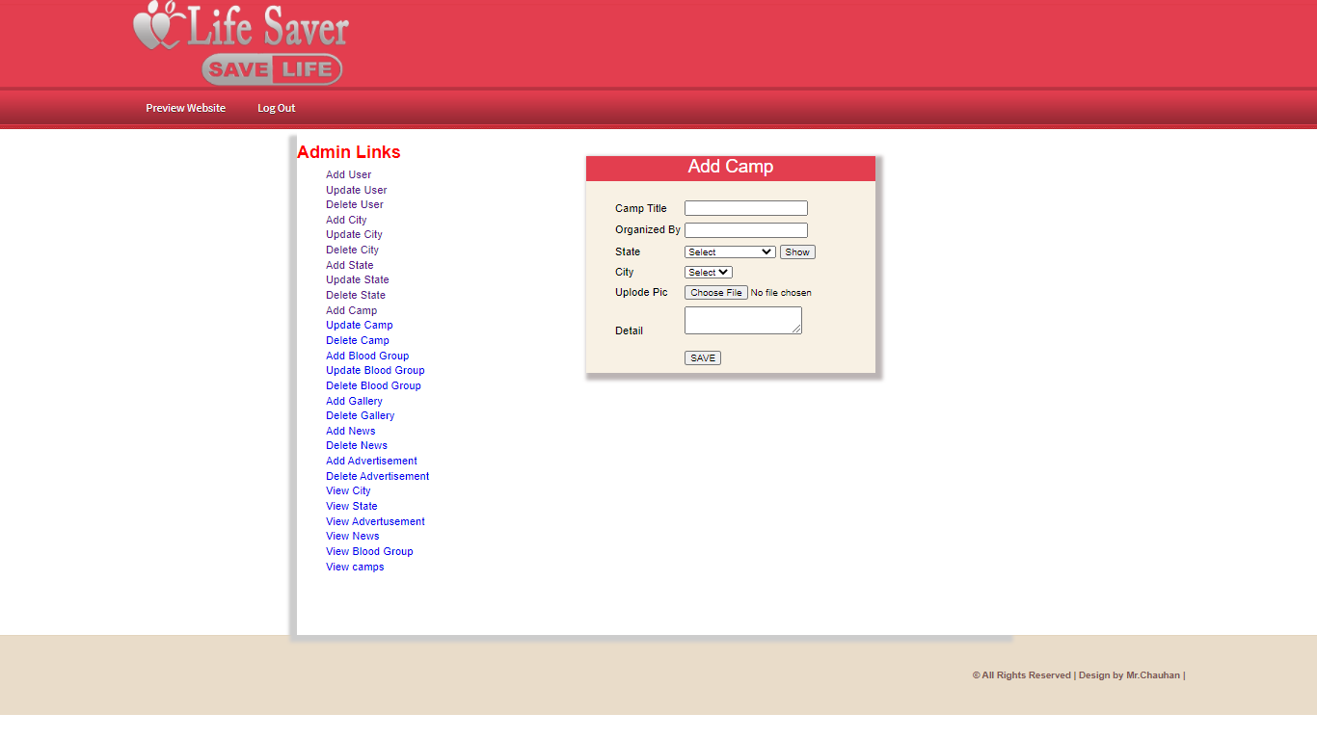
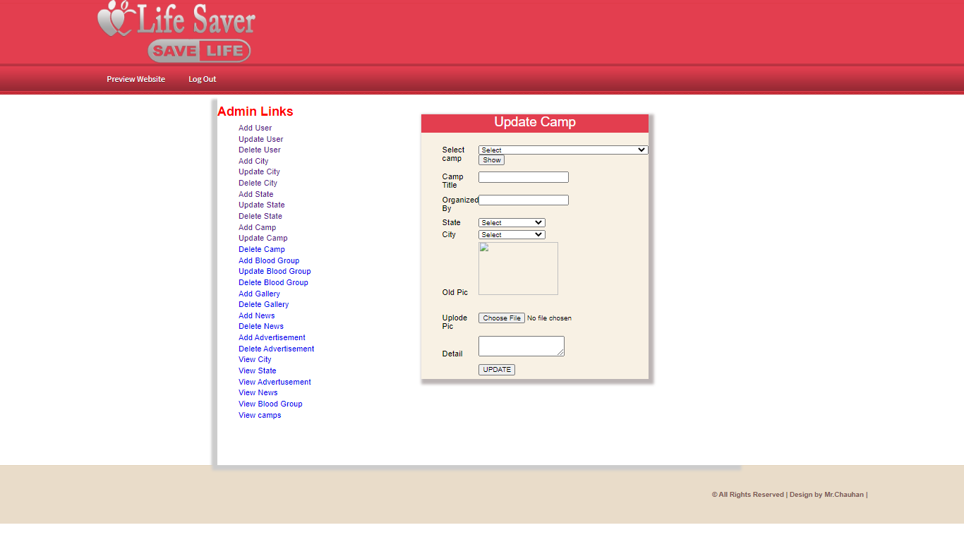


Slide 41




Slide 42
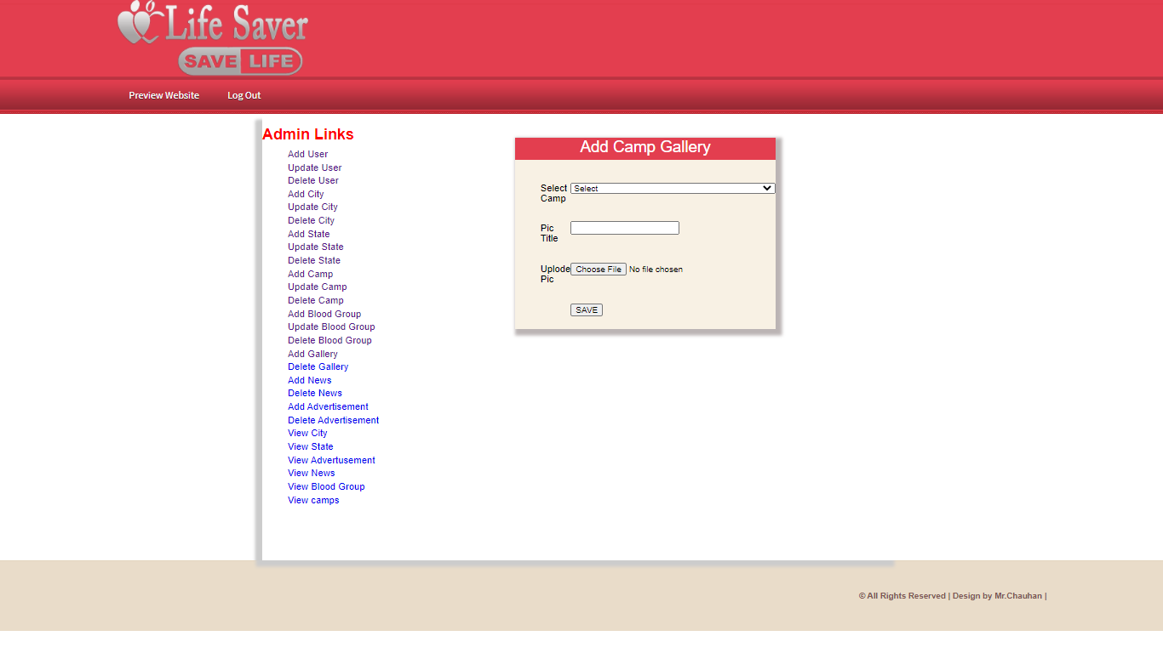


Slide 43



Slide 44



Slide 45
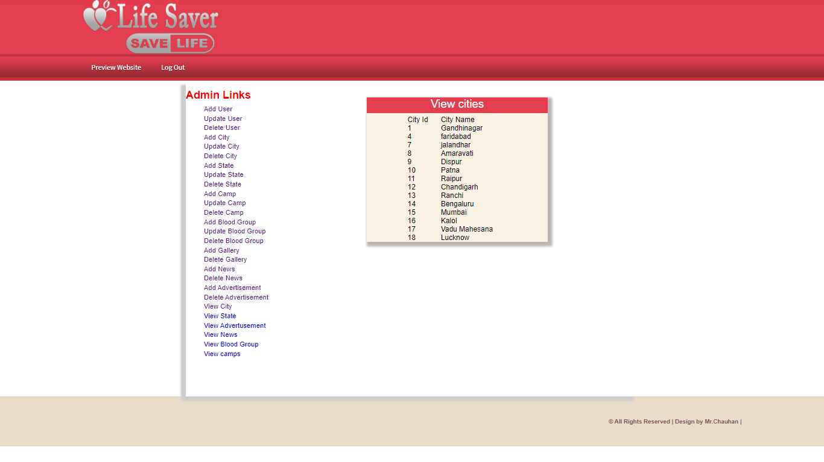
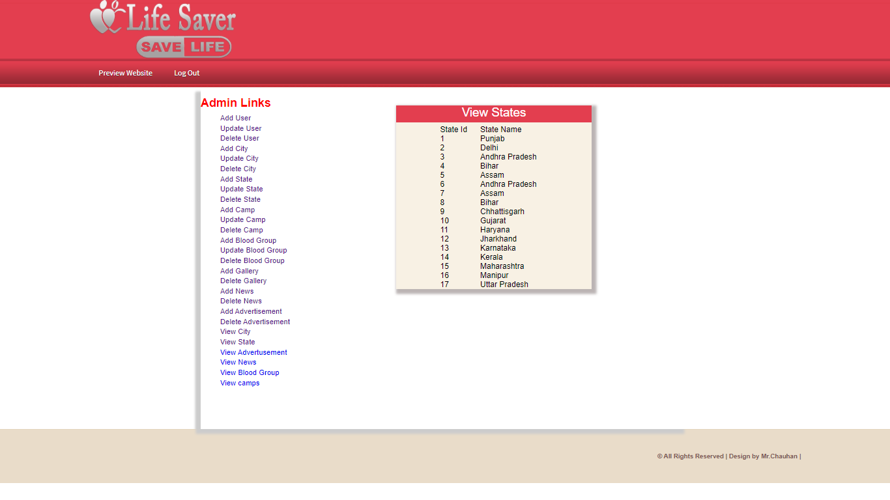
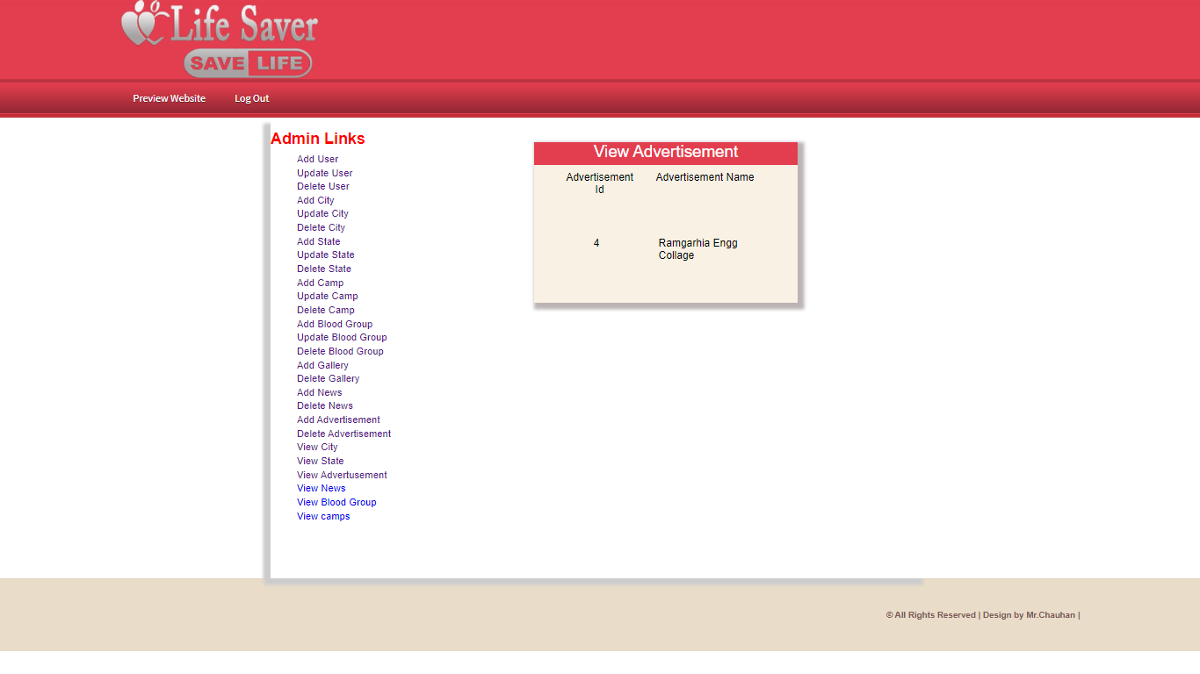
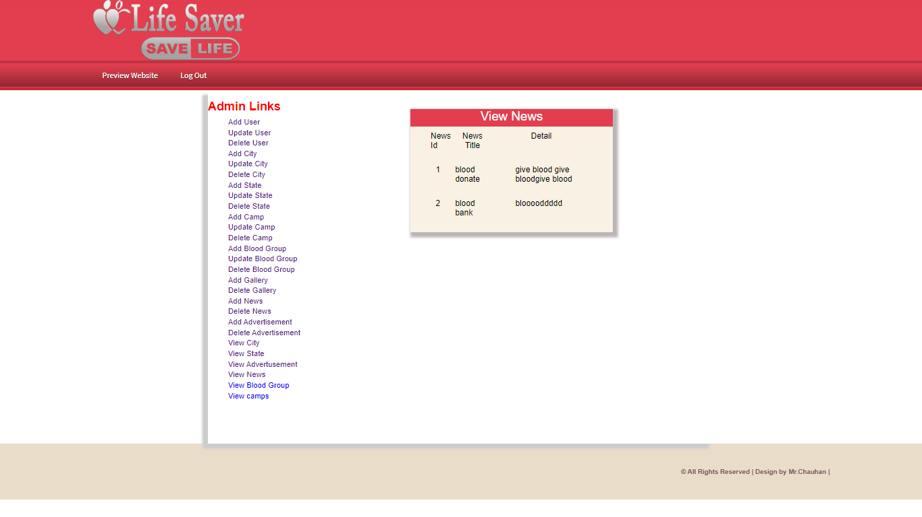
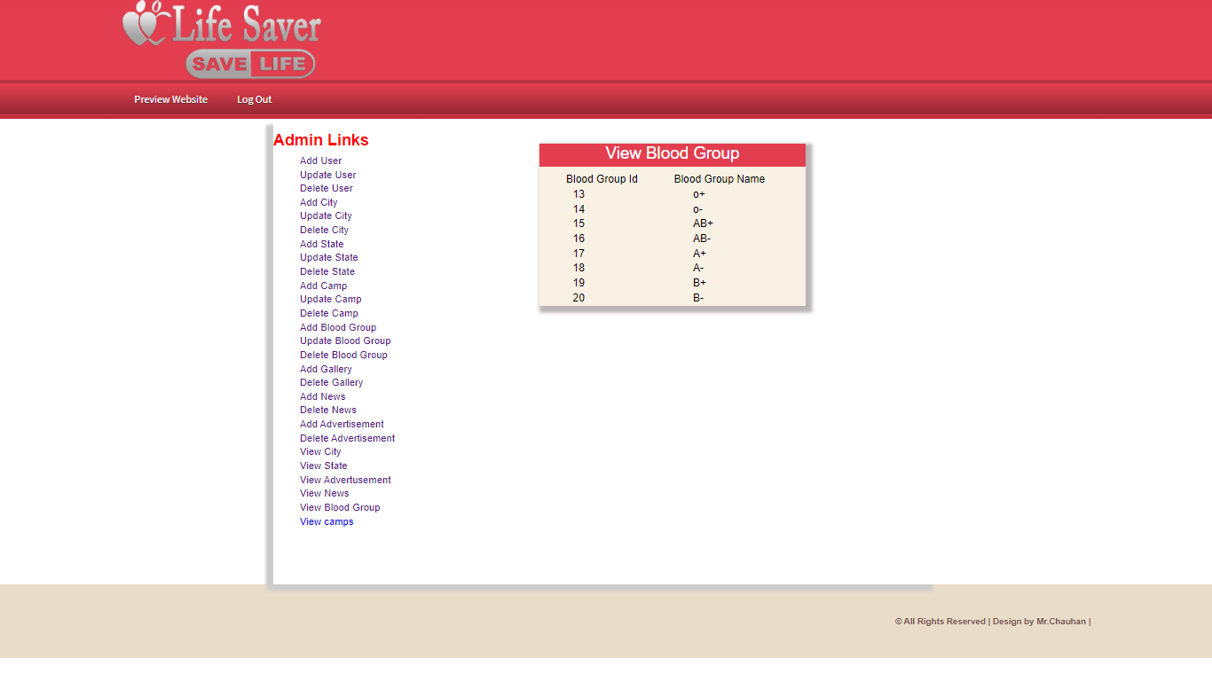
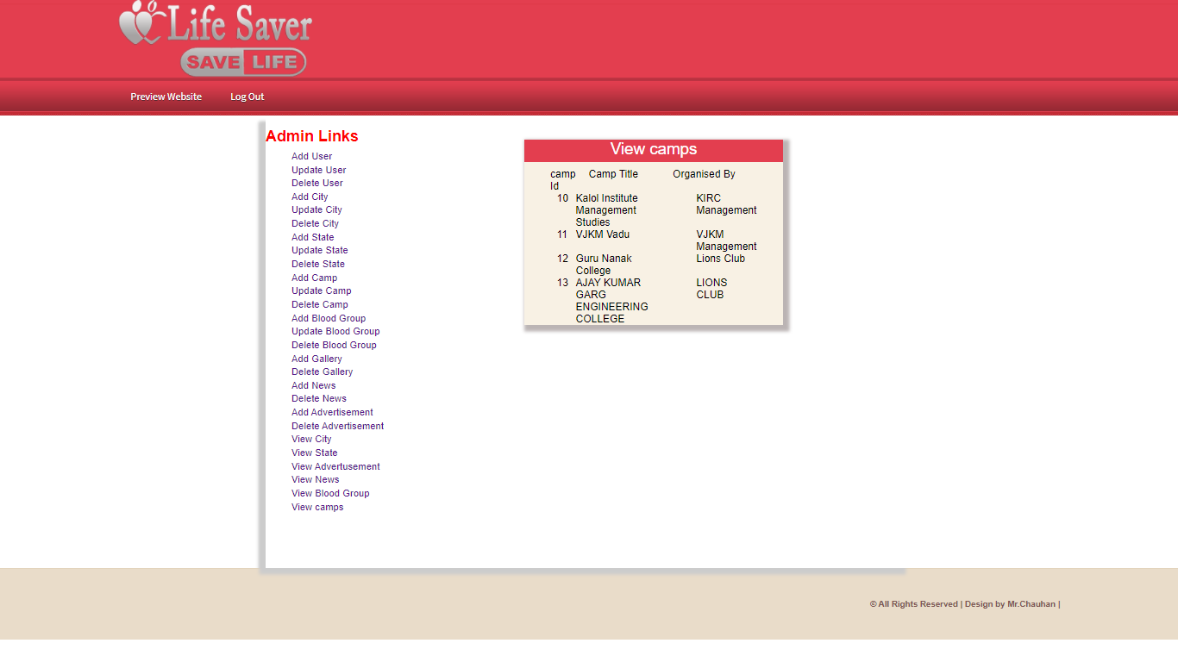

Slide 46
Thank You

